Slide 1
Logistic Regression

Slide 2
Classification
Logistic regression is classification algorithm
One of the fundamental model
Major diff in classification and regression is in regression target variable is continuous and for classification target variable will be discrete
In Supervised learning, we have dependent and independent variable, in which independent variable are features and dependent variable are target variable.
In classification:- Binary Classification (target variable can take 2 variable) and Multi Class classification (target variable can take > 2 variable)
Spam detection is binary classification (Yes or No) and bank offer credit card to it’s client ( Like Basic, Gold and Platinium)

Slide 3
Logistic Regression
Logistic regression is a supervised machine learning algorithm used for classification tasks where the goal is to predict the probability that an instance belongs to a given class or not.
Logistic regression is a statistical algorithm which analyze the relationship between two data factors. The article explores the fundamentals of logistic regression, it’s types and implementations.
Logistic regression is used for binary classification where we use sigmoid function, that takes input as independent variables and produces a probability value between 0 and 1.
For example, we have two classes Class 0 and Class 1 if the value of the logistic function for an input is greater than 0.5 (threshold value) then it belongs to Class 1 otherwise it belongs to Class 0. It’s referred to as regression because it is the extension of linear regression but is mainly used for classification problems.

Slide 4
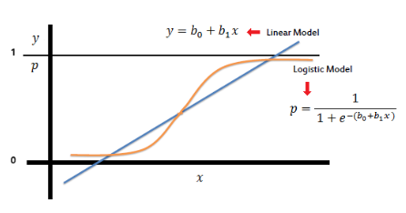
Key Points
Logistic regression predicts the output of a categorical dependent variable. Therefore, the outcome must be a categorical or discrete value.
It can be either Yes or No, 0 or 1, true or False, etc. but instead of giving the exact value as 0 and 1, it gives the probabilistic values which lie between 0 and 1.
In Logistic regression, instead of fitting a regression line, we fit an “S” shaped logistic function, which predicts two maximum values (0 or 1).
Means it separates or divide by category. And target variable Y is comprised of probability of a particular event occurring

Slide 5
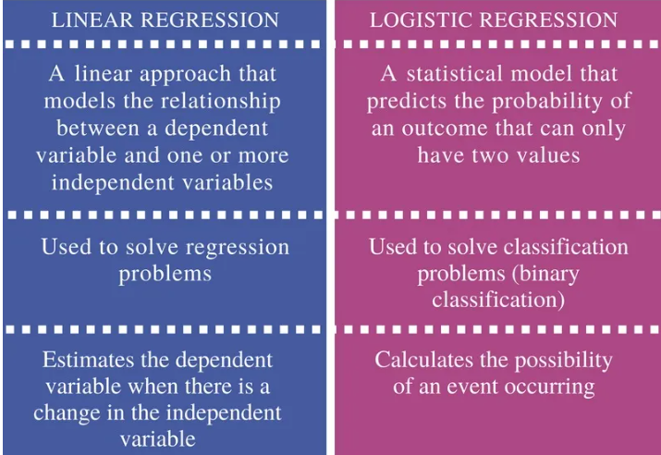
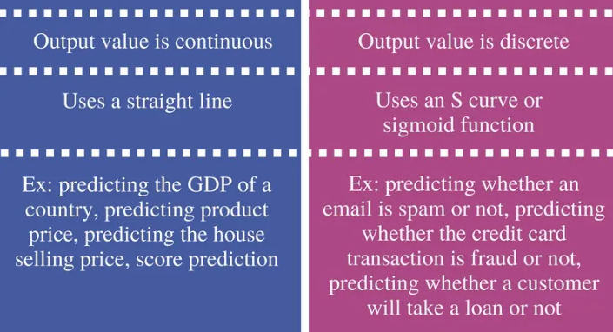
Diff between Linear and Logistic

Slide 6
FYI:-
Two types of Odds prob where odds in favour and Odds in against
So if probability is P then prob of odds in favour is P/(1-P)
And odd in against prob will be (1-p)/p

Slide 7
Logistic regression is called regression because initial output of logistic regression will be a continuous variable
Generally we are getting continuous variable as a output which we called regression but here we are finding out probability using sigmoid function and sigmoid function will give probability and we can associated probability with classification. Through cutoff we can classify it.
This is the basic path of logistic regression.
Generally we are finding Cost Function means Total Error function and using gradient descent, we are finding optimal parameter
Same thing we are doing in logistic regression as well
So here we have to create cost function for logistics regression.

Slide 9

Evaluation metrics for classification models
Accuracy :-
(TP+TN) / (TP+TN+FP+FN)
Precision:-
How well your model has predicted correctly out of total predicted
(TP) / (TP + FP)
Recall:-
Out of the once which were actually 1 , how many were you able to predict.
(TP) / (TP + FN)
F1 – Score:- below is called F beta score. If your beta = 1 then F1 score

Slide 10
F1 score defined as the harmonic mean of precision and recall.
Harmonic Mean:- The harmonic mean is used because it tends to balance out the extremes. When combining precision and recall, we want to avoid situations where one metric is high, but the other is low. The harmonic mean emphasizes low values more than the arithmetic mean, making it a good choice when you want to measure a balanced trade-off between precision and recall.
The F1 score is used when you need a metric that balances both precision and recall, particularly in scenarios where class imbalance exists or false positives and negatives have significant costs.
It's a good choice when you want to avoid a model that is overly focused on one metric at the expense of the other.

